Slide 1
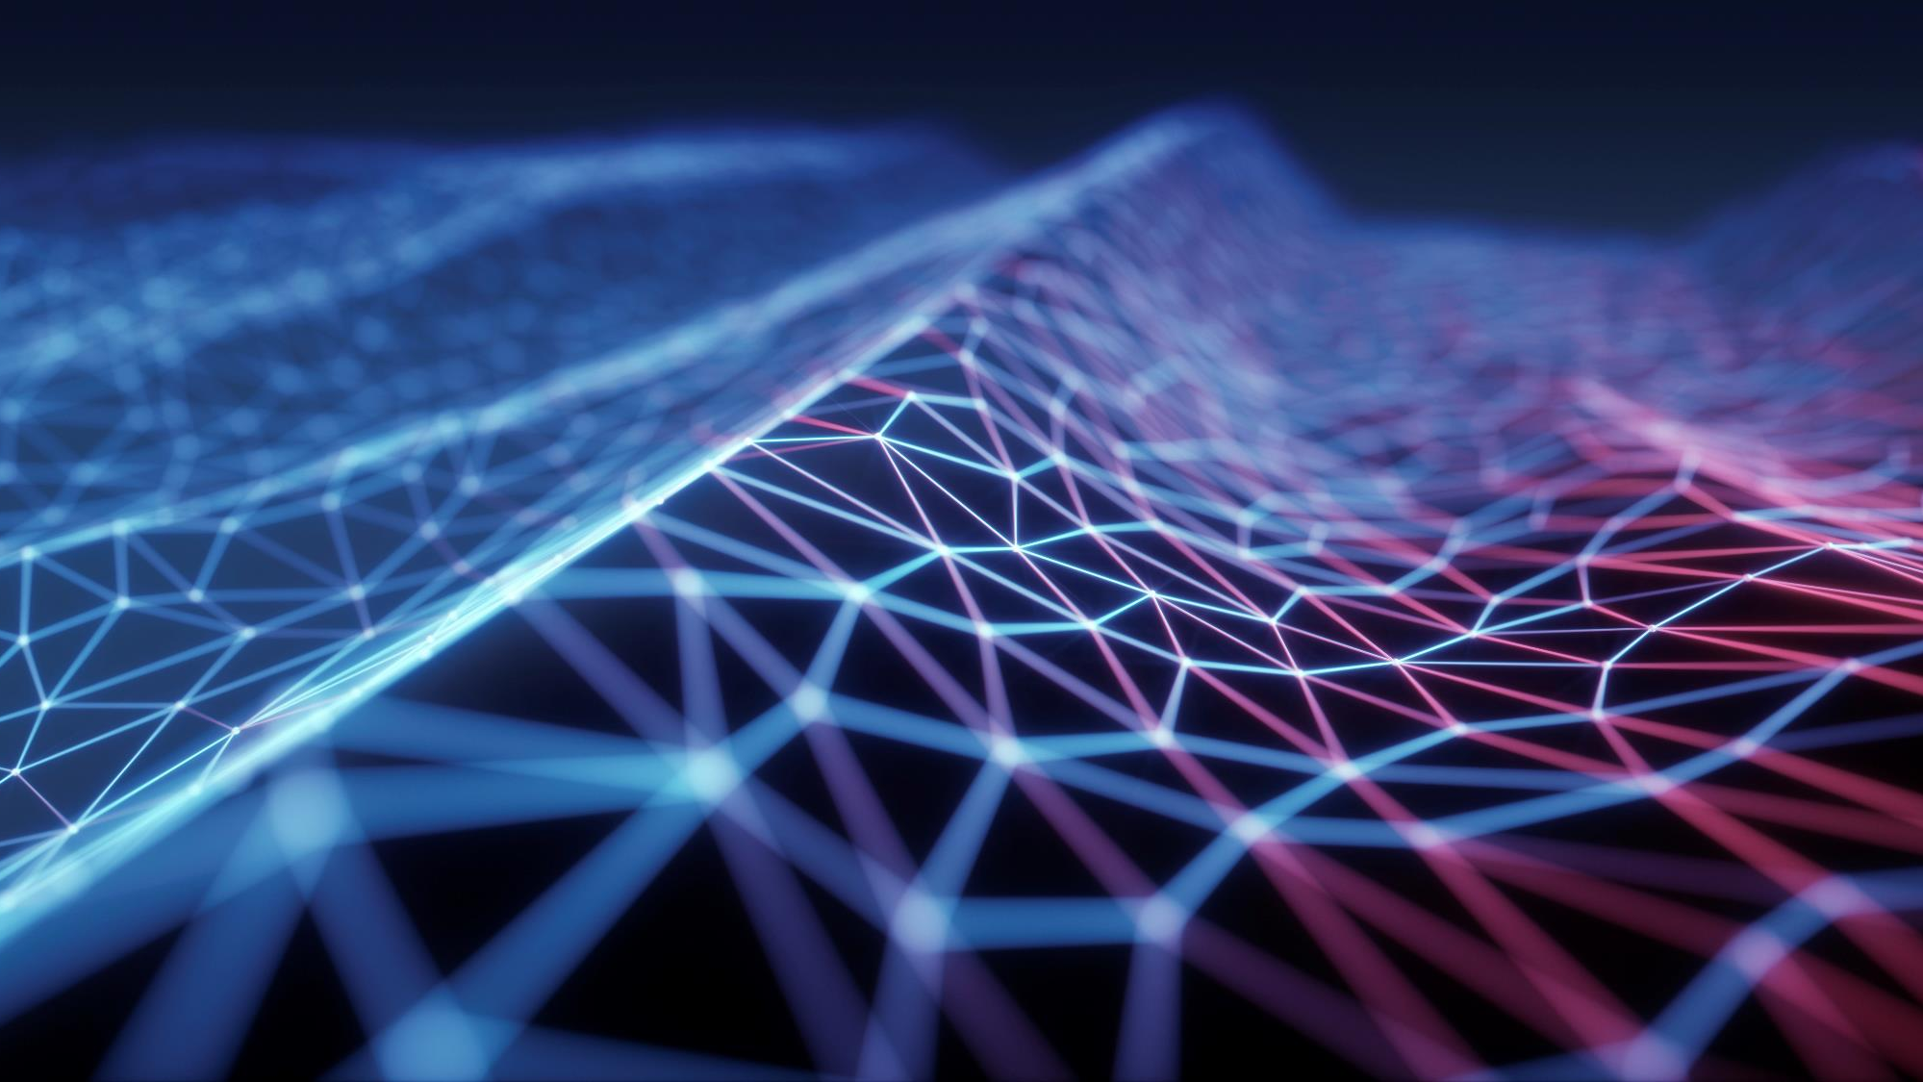
Tensorflow and applied machine learning cataract detection
Team 8
Adarsh rajesh
Archana Shivakumar
Chris john paul
Mudit chaturvedi

Slide 2
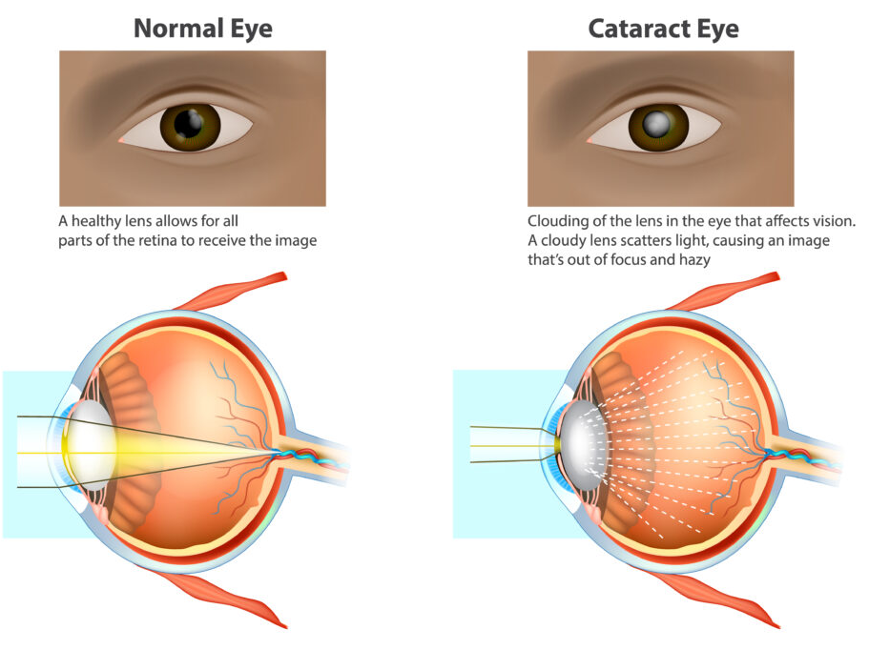
What is cataract?
A cataract is a clouding of the lens in the eye, which can lead to a decrease in vision. The lens is normally clear and helps focus light onto the retina, allowing us to see. When a cataract forms, it blocks or scatters the light entering the eye, causing blurry or dimmed vision.
Cataract surgery is an effective treatment, but early detection is key to managing the condition and preventing severe vision loss.

Slide 3
Problem statement
Cataracts are a leading cause of visual impairment and blindness worldwide, affecting millions. Many people, particularly in resource-limited areas, lack access to timely eye screenings by specialists.
Manual detection methods, typically involving ophthalmic examination, can be time-consuming, subjective, and resource-intensive, creating a barrier to early intervention.
The goal is to develop an automated cataract detection model using machine learning techniques.
This model could assist in the efficient, accurate screening of cataracts, allowing for quicker identification and intervention, and ultimately improving access to eye care in underserved regions.

Slide 4
dataset
The dataset we use consists of train and test directories, which we fit the model with.
Each of these train and test directories have 2 subclasses: Normal and Cataract
Each of these classes have several 100s of images
Traindata has 491 images and testdata has 121 images.
This dataset is downloaded from Kaggle.com
Reference: https://www.kaggle.com/datasets/nandanp6/cataract-image-dataset

Slide 5
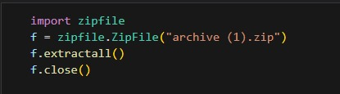
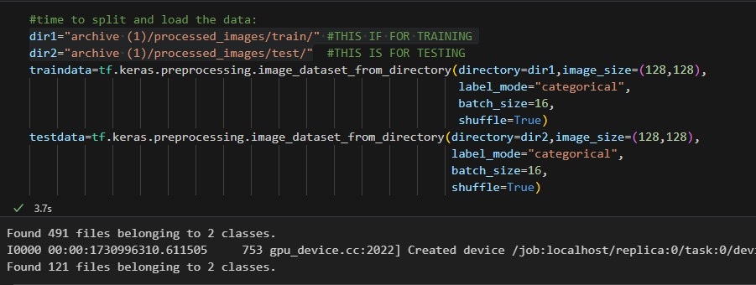
Data pre-processing

Slide 6
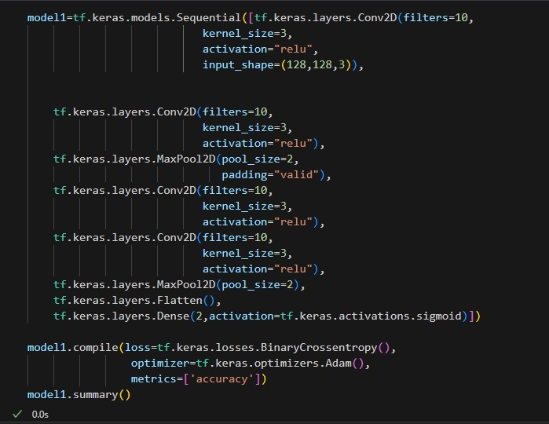
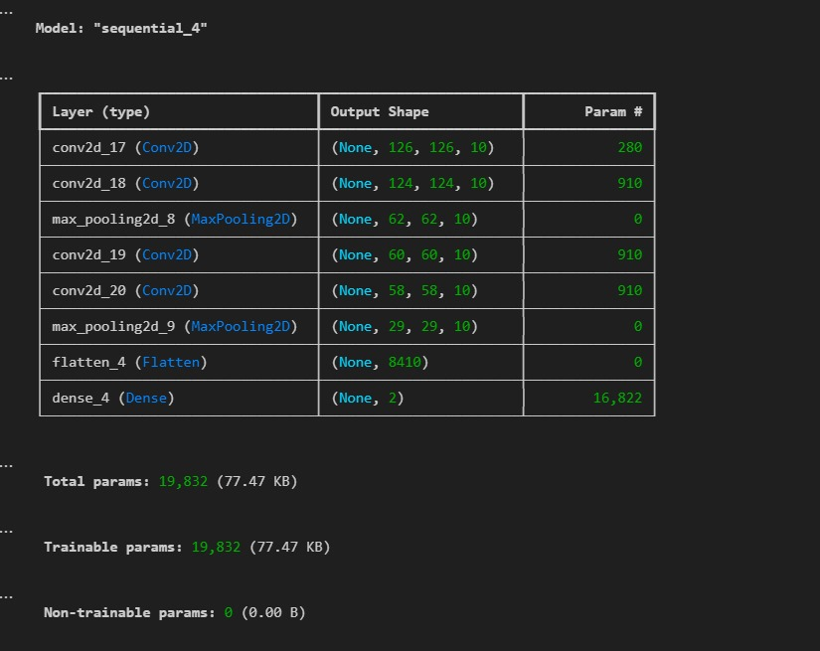
Model architecture

Slide 7

TRAINING THE MODEL
We fit the model with the Traindata(defined in data Pre-processing) and use Testdata as validation Data.
The epochs is set to 15 as by experimentation we have determined that it gives the best amount of accuracy and loss.

Slide 8


Results
We can see that the accuracy is 100% and loss is 0.0213, these are great parameters, Hence the model can be efficiently used for predictions.

Slide 9

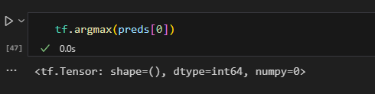
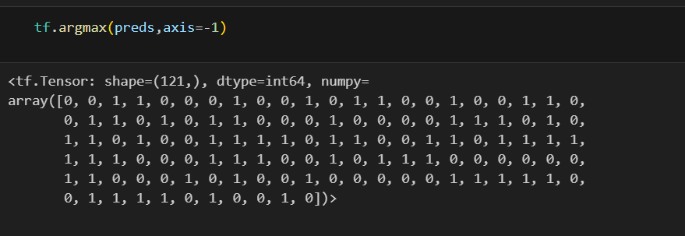
Predicting from testdata
Here, it shows that the argmax of predicted value is in index 0 of classes, Lets check this.
Each element of array corresponds to the classes, 0 is cataract, 1 is Normal. This array directly tells the predictions of all the data of testdata.
We can see that the Model successfully predicted that given testdata was a Cataract image.

Slide 10
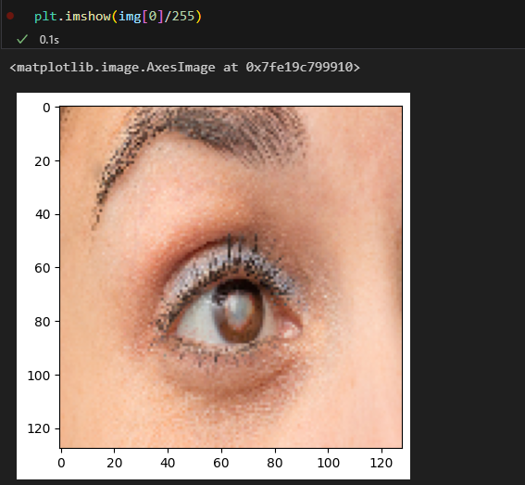

We can see that the Model successfully predicted that given testdata’s first image was a Cataract image.

Slide 11
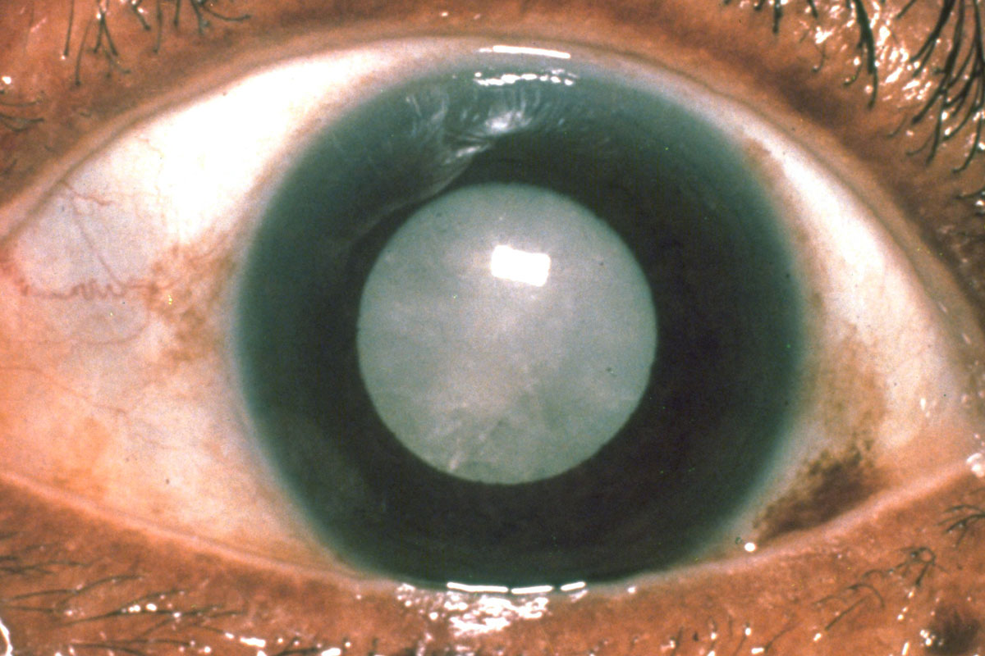
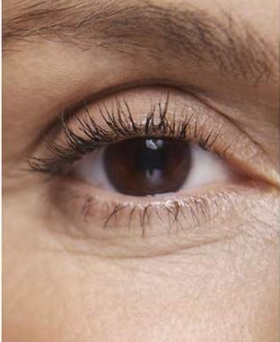
TIME FOR PREDICTING OUR OWN INPUTS :) we are going to pass these both images which are downloaded from google and pass it to our model for predictions
CATARACT.png IMAGE FROM GOOGLE
NORMAL.png IMAGE FROM GOOGLE

Slide 12

Thank You
To: UJJWAL MK
PESU IO TEAM

